Slide 1
Getting Started with the Grants Portal Grants.gov Proposal Instructions
June 2017

Slide 2
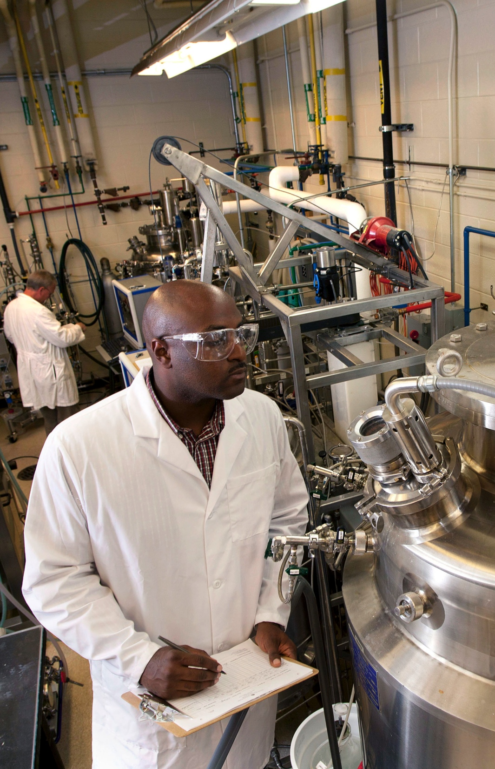
What is the Grants Portal?
Workflow
Document Management
System to System Submission
Reporting
Notes:
The Grants Portal is an interactive tool designed to integrate proposal development, submission, and approval with award management, modifications, renewals, no-cost extensions, and the like. It handles all types of sponsored projects grants, contracts, cooperative agreements, MOAs and MOUs, as well as public service and outreach, instruction, research, experiment station, and cooperative extension submissions.
Early on in the implementation we focused on proposal development, submission, and approval.
Later we pivoted to organization of documents, transparency, an award management.
Now we are working on streamlining processes and enhancing the features available to faculty and staff and integrating with the new One Source financial software.
With all the data we are collecting in the Grants portal, we have greatly enhanced our reporting capability and the ability to communicate with targeted groups of PI’s. For example we can forward an NSF supplement opportunity to everyone who currently has an NSF grant.

Slide 3
What can the Grants Portal do?
The Portal can be used to:
1. Track proposals and awards – look at the “State” of the project or the flow chat at the top of any proposal workspace.
2. Submit Proposals to Grants.gov and review non-grants.gov submissions
3. Route and Sign “transmittal forms”
4. Communicate with your proposal team – email within The Portal
5. Organize your documents and create a complete record of your project from proposal to closeout.
Notes:
Graduate student

Slide 4
Tracking Proposals and Signing Transmittal Forms: My To-Do List and My Proposals
Navigating the Portal
1. Under My Proposals you can see all the proposals you have ever submitted and what state they are in.
2. Under the To-Do List you can see all the proposals waiting for you to approve the transmittal form.
3. Also under the To-Do List you can see all the proposals on which you are a proposal team member that have not been submitted to the sponsor yet.
4. Under the My Award area you can see all your awards.
Notes:
Graduate student

Slide 5
Tracking Proposals and Signing Transmittal Forms: My To-Do List
How to Prepare and Submit Proposals
Notes:
When you login to the Portal, the first page you see will be your To-Do List. This page will have items on which you need to take action. For example, proposals where you need to submit for University Approval or Approval transmittal forms. It might also have requests for information in order to process awards. On the left hand side you will see reminders about required training and a notice if your SFI Disclosure is soon to expire.

Slide 6
How to Prepare and Submit Proposals
There are 6 steps to Create a Grants.gov Proposal:
Step 1 – Start a New Proposal
Step 2 – Proposal Information
Step 3 – Create Federal Application Package
Step 4 – Complete the Federal Package & Upload Attachments
Step 5 – Submit the Proposal
Step 6 – Approve PI Certifications

Slide 7
Step 1 – Start a New Proposal
In order to create the funding proposal you need to first login to the Grants Portal at http://ovpr-grants-prod.ovpr.uga.edu/grants
Once you login, you will be directed to a landing page. Look in the upper left-hand section of the page. Click the blue “Create New Proposal”.

Slide 8
Step 1 – Start a New Proposal

Slide 9
Step 2 – Proposal Information
Notes:
Once you click the “Create a New Proposal” you will automatically enter the Proposal Smart Forms. The first page you see will be Basic Proposal Information (page 1 of 2). These forms allow you to enter information about your proposal to be used on the transmittal form and on the federal application. You can fill out all the screens now, or you can fill out what you know, and save the rest for later. The more you fill out on these pages, the less you will need to fill out on the federal forms themselves.
Hints and helpful pieces of information about how to answer the questions can be found on the right hand side of the screen next to each question.
Once you complete the Proposal Smart Forms hit finish or exit (if the form is incomplete) and you will move on to Step 3. Please know you have to fill out the first page or the system will not create a proposal workspace.

Slide 10
Proposal Workspace
Notes:
When you complete the proposal smart forms you will be directed to the Proposal Work Space. At the top of the screen you can see key identifying information about the project like the PI name, the sponsor, the management unit, project start and end dates, as well as your SPA Pre-Award contact.
Additionally, notice the progress bar along the top of the screen. This lets you know quickly where your proposal is in the review process.
Another key feature is the action item buttons. In the center of the screen will be buttons corresponding to any actions required on your part. This may be submitting the proposal for University review or approving a transmittal form.

Slide 11
Proposal Workspace
Notes:
Scrolling down the page on the proposal workspace you can see the transmittal and background information pages. Green Checks means the pages are complete. Red X’s mean they are not. You can click on any page and navigate directly to it instead of paging through each proposal smart form.

Slide 12
Proposal Workspace
Notes:
At the bottom of the proposal workspace is the project history, and proposal documents.

Slide 13
Step 3 – Create SF424
The next step takes the information you have entered into the proposal smart forms and combines it with known institutional information and prepopulates your Federal Application package, all with the click of a button!!
Click the Federal Application Package button on the left-hand side of the screen and select Create/Update SF 424. Click OK in the Pop up window.
The SF424 forms (aka the federal application package) will be automatically generated from the information you have entered and a link will appear on the Funding Proposal Workspace for your proposal under the grey heading Federal Application Package.

Slide 14
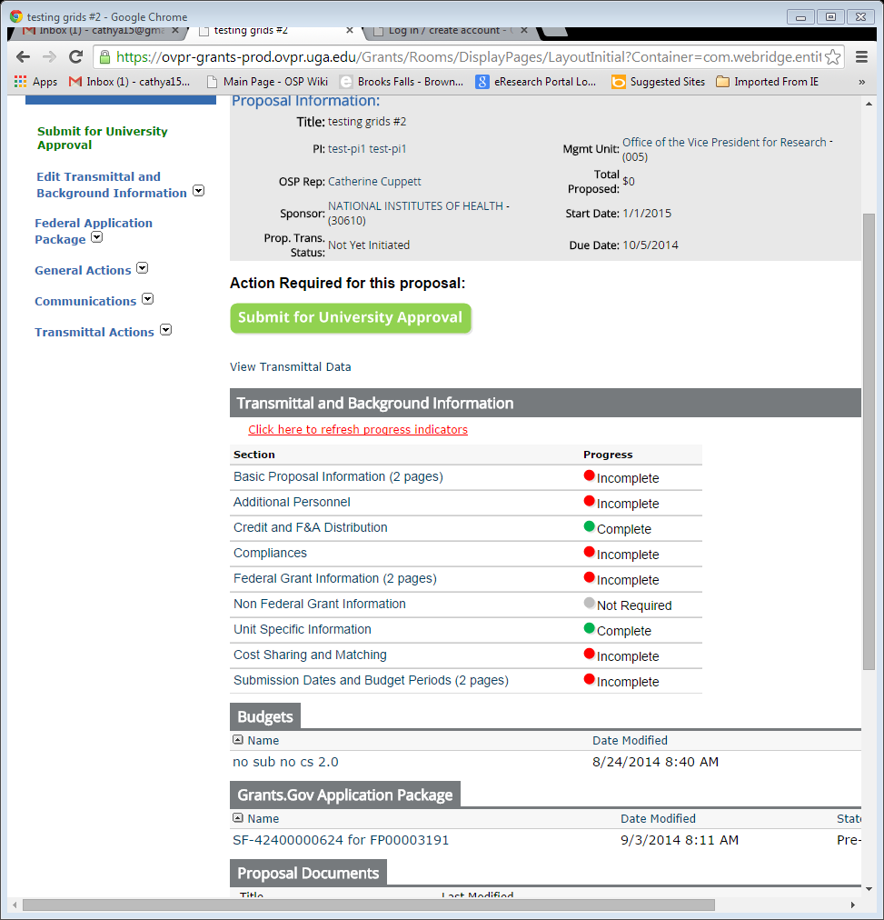
Step 3 - Create SF424
Notes:
Click on the federal application link in the upper left of the screen to create the actual federal proposal package to be submitted to Grants.gov. You will get a pop up window. Click “ok” only once. The window will automatically close once the process is complete and the page will refresh to show the Grants.gov Application Package link on the middle/bottom of the page.

Slide 15
Step 4 – Complete SF424 & Upload Attachments
Using the RFP and grant application instructions as a guide, select the appropriate forms for your submission.
Go through the Federal Application Package to verify that the information from Steps 2 and 3 have been entered into your proposal. Fill in any fields which have not been completed and upload all required documents. Examples of required documents are project description, research strategy, budget justification, bio-sketches, etc.
Once you get to the end of the form set, click “Hide/Show Errors” on the light blue strip located on both the top and bottom of the screen. This will alert you to any missing or contradictory information entered into the Federal forms. A list will appear which will hyperlink you back to problem areas. Once you are done correcting errors, click FINSH.

Slide 16
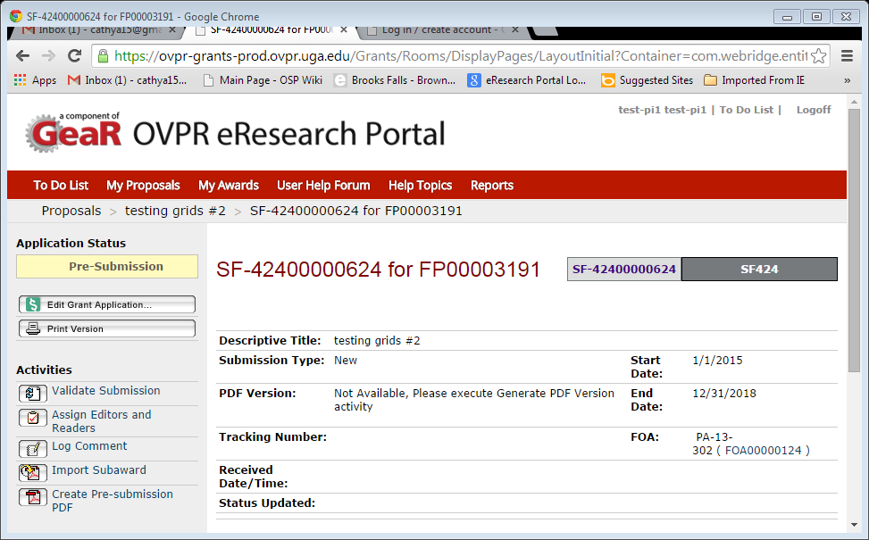
Federal Forms Work Space
Click Here to Enter Federal Forms

Slide 17
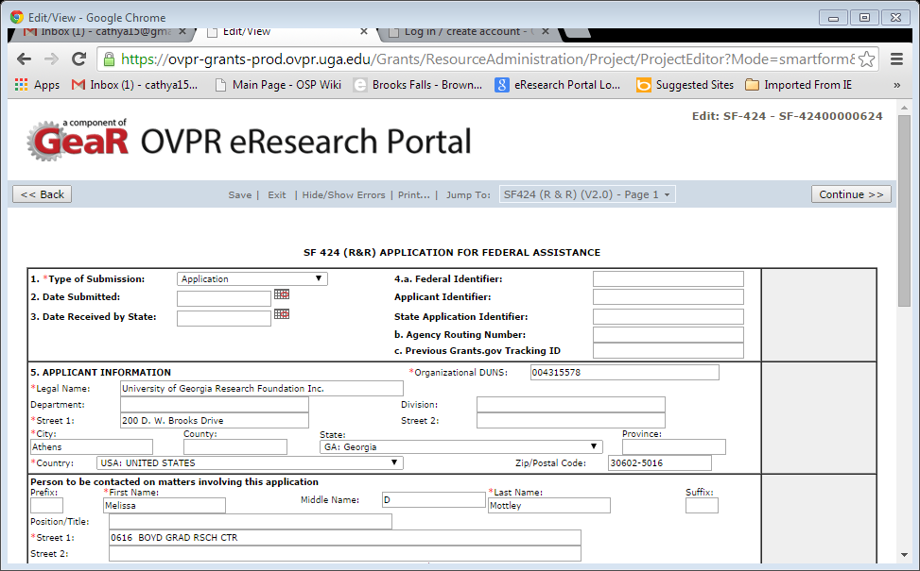
Federal Forms
Hide/Show Errors

Slide 18
Step 5 – Submit Proposal
In order to submit your proposal for approval, hit the green Submit Proposal Button in the center of the Proposal Work Space.
Once you hit this button your proposal will be routed for review by the appropriate parties at UGA.
The submit proposal button does not submit your proposal to the sponsor.

Slide 19
Step 5 – Submit Proposal

Slide 20
Step 6 – PI Certifications
Once you click the green submit button you be presented with the PI certifications screen. Instead of filling out the whole transmittal form, you only need certify whether you have a conflict of interest or not, and whether you have completed lab safety training or not and click “ok”.

Slide 21
Step 6 – Approve PI Certifications
Click Yes or No
for financial conflict
of interest and lab safety training, then click ok

Slide 22
Submission Complete!
Congratulations!! You have submitted a Grants.gov proposal for review and approval to your DLSA and Sponsored Projects.
Please note that you have not submitted a proposal to a sponsor. Only Authorized Institutional Officials can submit proposals to Grants.gov. As such, either your DLSA or your Sponsored Programs Representative will submit the proposal to Grants.gov.

Slide 23
Best of Luck with your proposal ☺
Notes:
If you have questions, please contact a SPA Representative via the SPA site http://spa.uga.edu.

Slide 24
spa.uga.edu

