Slide 1
The Grants Portal: An Overview
Catherine Cuppett, January 2017

Slide 2
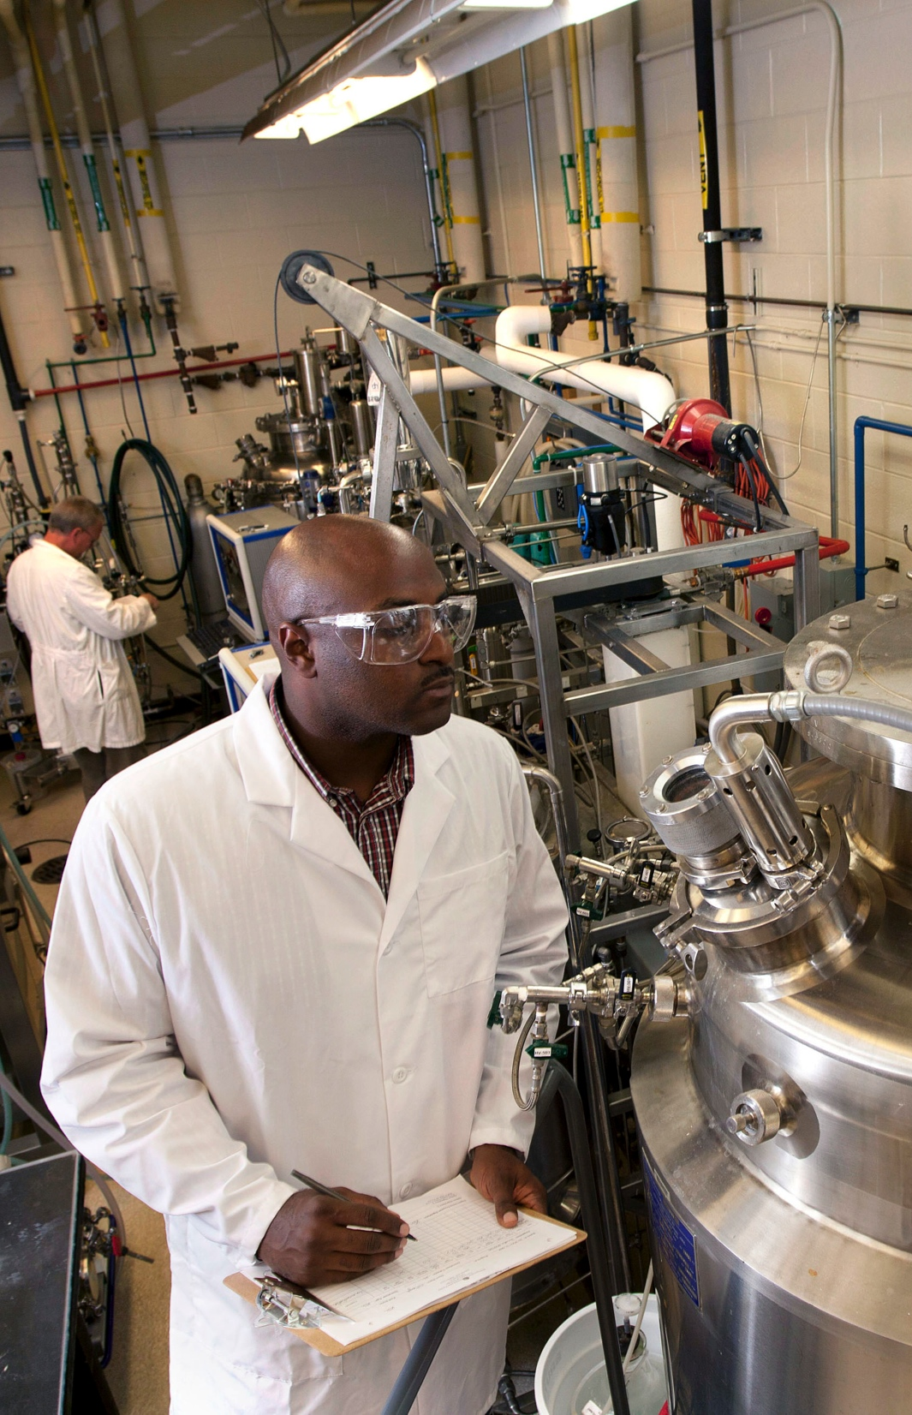
What is the Grants Portal?
Workflow
Document Management
System to System Submission
Reporting
Notes:
The Grants Portal is an interactive tool designed to integrate proposal development, submission, and approval with award management, modifications, renewals, no-cost extensions, and the like. It handles all types of sponsored projects grants, contracts, cooperative agreements, MOAs and MOUs, as well as public service and outreach, instruction, research, experiment station, and cooperative extension submissions.
Early on in the implementation we focused on proposal development, submission, and approval.
Later we pivoted to organization of documents, transparency, an award management.
Now we are working on streamlining processes and enhancing the features available to faculty and staff and integrating with the new One Source financial software.
With all the data we are collecting in the Grants portal, we have greatly enhanced our reporting capability and the ability to communicate with targeted groups of PI’s. For example we can forward an NSF supplement opportunity to everyone who currently has an NSF grant.

Slide 3
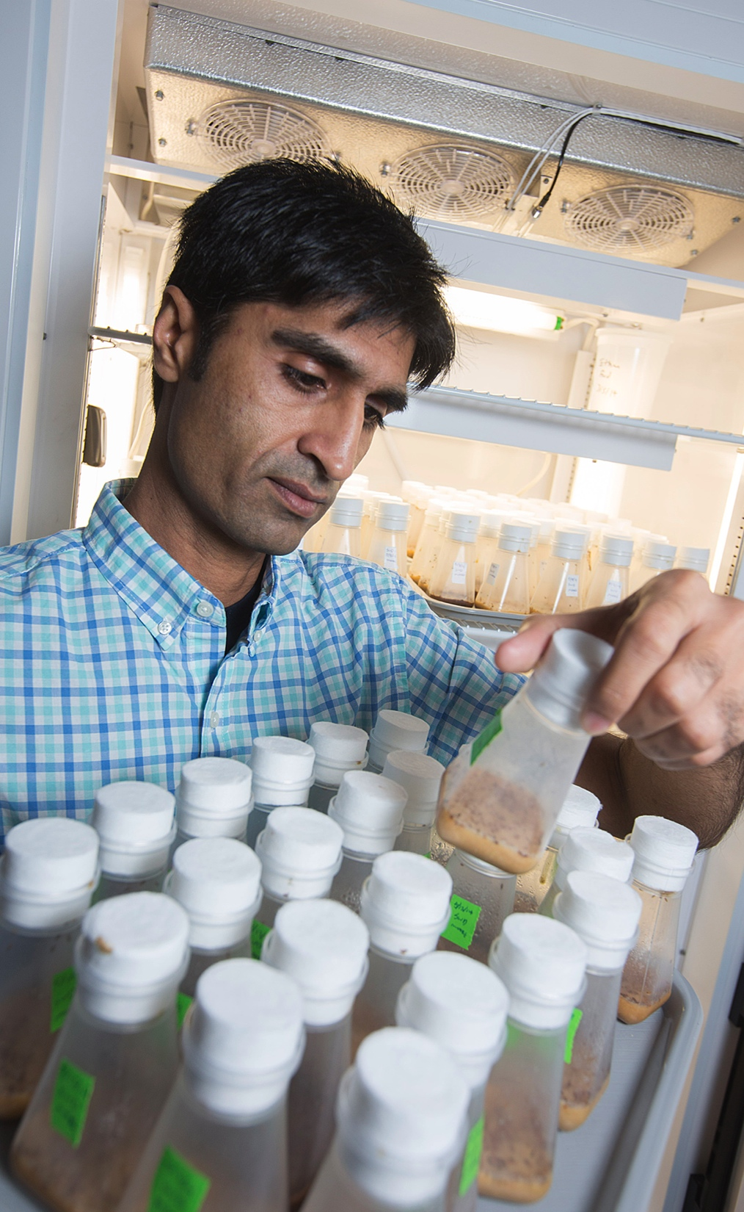
What are the main parts?
The To-Do List
Training Reminders
My Projects
My Awards
Reports
System to System Submission
Notes:
Under the To-Do List you can see all the items which require your attention, whether those are projects waiting for you to do your COI certification or revised budgets needed for award.
Additionally, on the login page Reminders to renew your SFI Disclosure and your CITI training required on PHS Funded projects as well as the AHA show up here.
3. Under the Projects tab, you can see all the projects you have ever been a part of.
4. Same as the Award Increments tab
The reporting tab contains various individual and department level reports based on your role and permissions in the Portal as well as institutional wide reports.
The Portal interacts directly with Grants.gov so we do not have to wait in line. It provides a more user friendly interface then the traditional grants.gov pdf forms and allows multiple people to work on the federal package without worrying about if you have the most recent copy. It also validates and pre-checks the submission to ensure the package will pass through the electronic sumbmission systems effectively.

Slide 4
How can it help me as a researcher or as an administrator?
Organizes Workflow
Organizes Documents
Increases Transparency
Creates a Record
Notes:
Track all your projects - proposals and awards – look at the “State” of the project or the flow chat at the top of any proposal workspace.
Organize your documents for all your projects in one accessible online place. Everyone sees the same things on the proposal team and research administration. Reduces confusion.
4. Transparency - Communicate with your proposal team – email within The Portal, email your Pre-Award Rep or your DLSA as well as recording actions on projects
5. The record of actions, the emails and the documents all create a record of your project for inception to closeout.

Slide 5
Organizing your Workflow
The Portal organizes your workflow through the use of:
1. Roles – each role in the Portal corresponds to different views and permissions. Different roles allow for different activities like – proposal submission to an agency, transmittal approval, editing the proposal, etc.
2. States – each state corresponds with a specific point in the life cycle of the project. There are separate states for proposals and awards. As a cheat sheet you can look at the workflow diagram at the top of the proposal workspace to see where the project is in its life cycle.
3. Comments and the History – additional details added by the project team and research admins.
Notes:
David Chu, Pharmacy: Distinguished research professor, emeritus

Slide 6
the

Slide 7
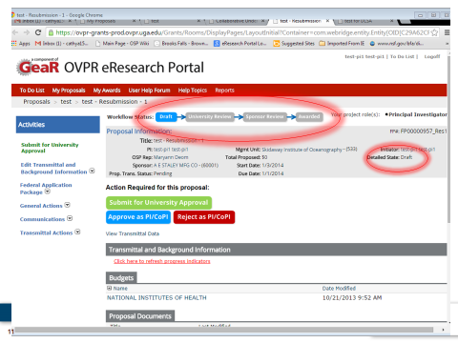
Notes:
The state/workflow diagram helps identify where a project is in its lifecycle. As the project moves through the phases from inception (draft state) to Awarded and the No Cost Extension period, you can see that in the project state. Additional information can be seen in the detailed state.

Slide 9
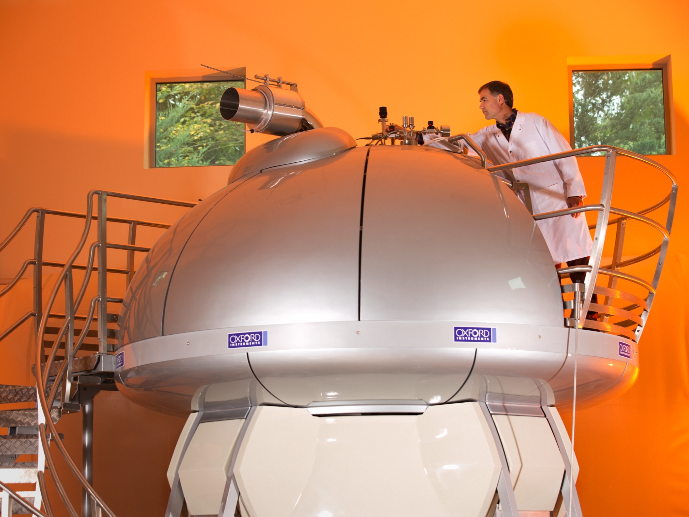
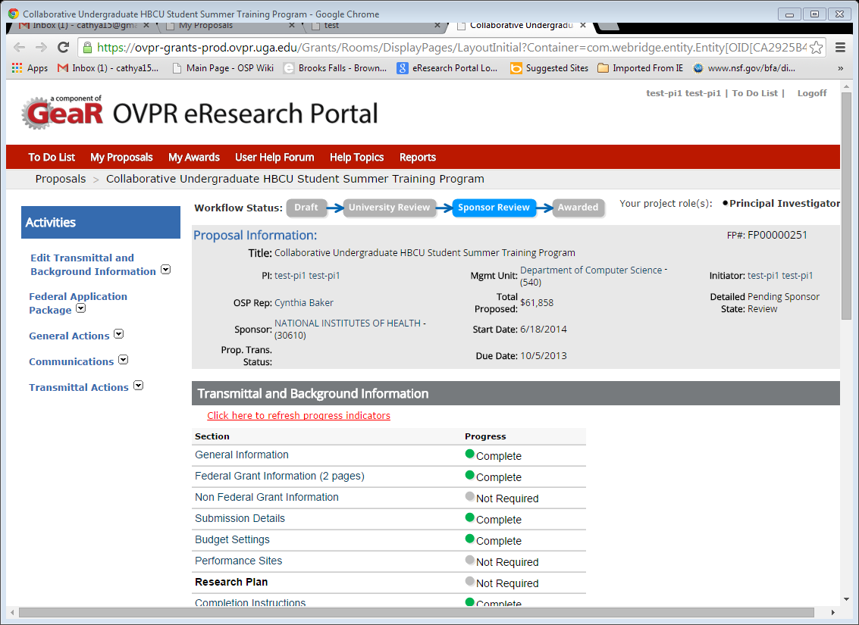
Research fact
Bullet point
Notes:
Art Edison, metabolomics: GRA Eminent Scholar, professor of genetics, director of Southeast Center for Integrated Metabolomics

Slide 10
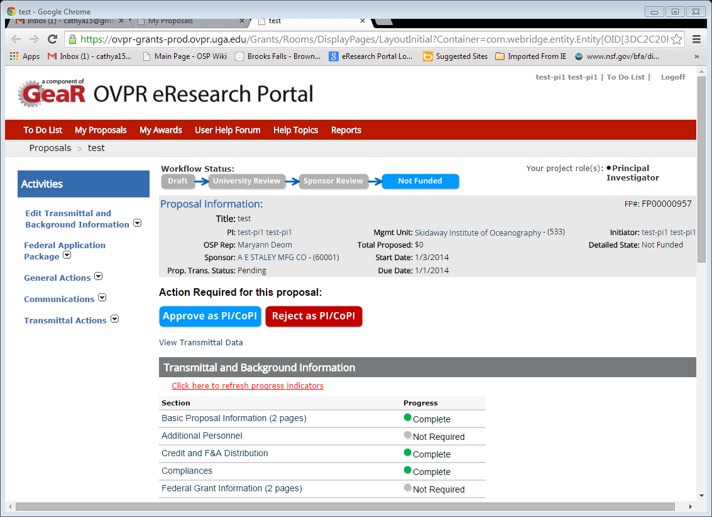

Slide 12
Organizing Documents
All the documents for a project will now be visible with only a few clicks:
The Proposal Documents
The Award Documents
Sub-Award Documents
No Cost Extension Documents
Quantified Committed Effort
Notes:
David Chu, Pharmacy: Distinguished research professor, emeritus

Slide 13
Notes:
At the bottom of the project workspace, you can see the proposal documents as well as links to the award increments and their respective workspaces

Slide 14
Notes:
Award documents and proposal documents are displayed on the award workspace for easy referencing.

Slide 15
Notes:
If you click on one of the document links you can see the actual document. Above is an example of our quantified committed effort document.

Slide 16
Notes:
At the bottom of the award workspace is a link to any affiliated subs.

Slide 17
Notes:
Subs also have histories and document tabs where you can see all the partially signed and fully executed increments. As well as the timeline for signautres and what if anything we are waiting for – Audit forms, the other institution to sign, etc.

Slide 18
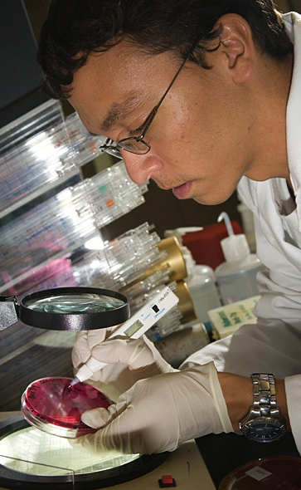
Increased Transparency
Emails
Actions
Comments
Approvals
Notes:
The Portal records all actions taken in the Proposal History at the bottom of the workspace screen.
1. Emails: The Portal allows anyone to send an email to everyone on the proposal team, only to the DLSA, and only to the SPA Rep. Members of the proposal team are readily identifiable by clicking on the contacts tab in the proposal workspace. Emails sent through the Portal are then logged in the comments section and preserved and associated with this project forever.
The Portal sends out emails which are logged and recorded in the comments area. These emails remind people to approve transmittal forms, send award documents to SPA, and alert administrators if the proposal is not funded.
2. Actions: The Portal records state changes, the time they are made and who makes them. This allows for greater transparency in processing time of transmittal forms, awards, and subs.
3. Comments – Comments can be added to the history by any member of the proposal team. Comments should be used by the DLSA’s to show when a proposal is submitted. They are also used by the SPA Rep to show why an award has not yet been processed or where a sub is in the process.
4. Approvals – the history also records each transmittal form approval and the notification sent to the next approver.

Slide 21
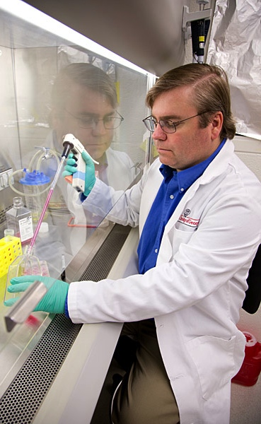
Creating a Record
All of these things together help create a permanent record of what has happened with a project from creation to completion.
Notes:
Mark Tompkins, Department of Infectious Diseases, College of Veterinary Medicine: associate professor

Slide 22
Interested in learning more?
Notes:
Portal Open House – happens Quarterly. Check our calendar ☺
GRASP Class on the Portal – Make and track a proposal
Individual or departmental training by request

Slide 23
sponsoredprojects.uga.edu

